Slide 1
Open-domain Knowledge Extraction
Niranjan Balasubramanian
University of Washington

Slide 2
Motivation
Why should you care about knowledge extraction?

Slide 3
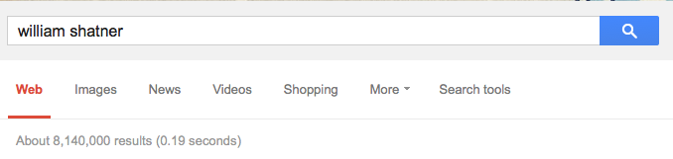
Organizing Information About Entities
Notes:
Suppose you want to find information about William Shatner. If you search, you get more than 8 million results.

Slide 4
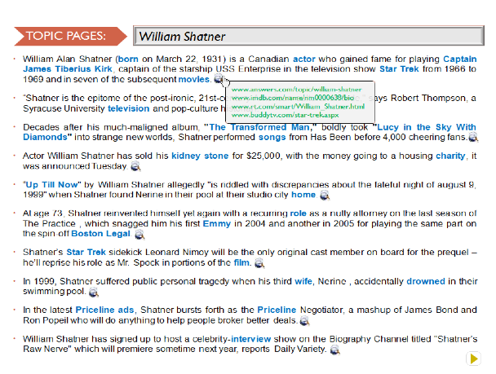



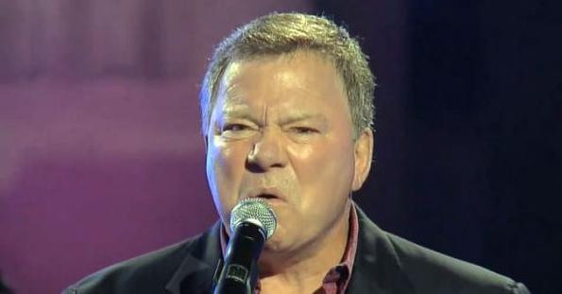
Organizing Information About Entities
Automatically generate a topic page for an entity.
Need knowledge about salient aspects!
Notes:
Wouldn’t it be convenient if you have a topic page that covers information about the various facets of William Shatner?
To build these types of pages automatically you need knowledge.
You need to know which are the most important pieces of information to cover.

Slide 5
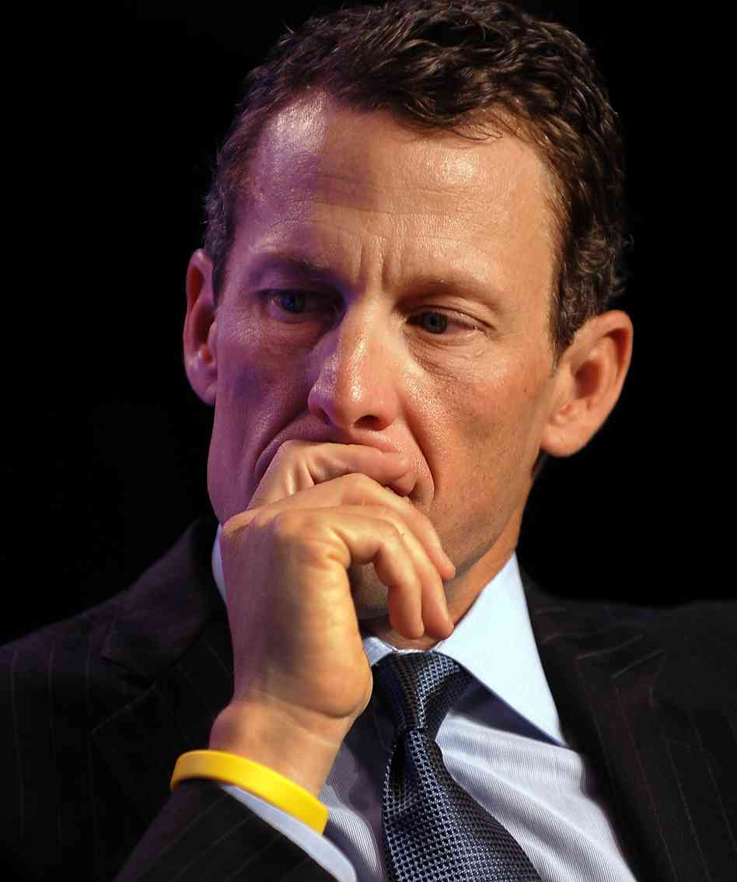
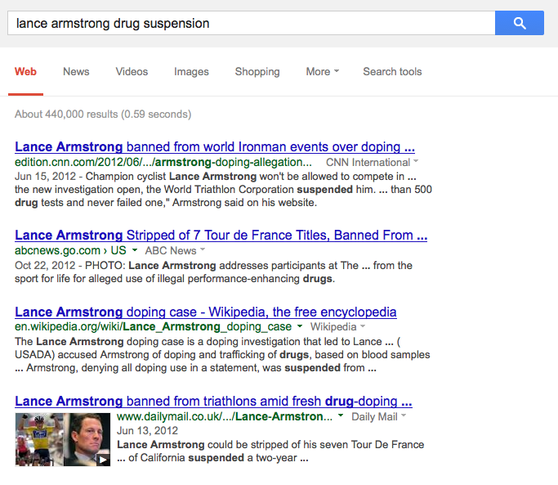
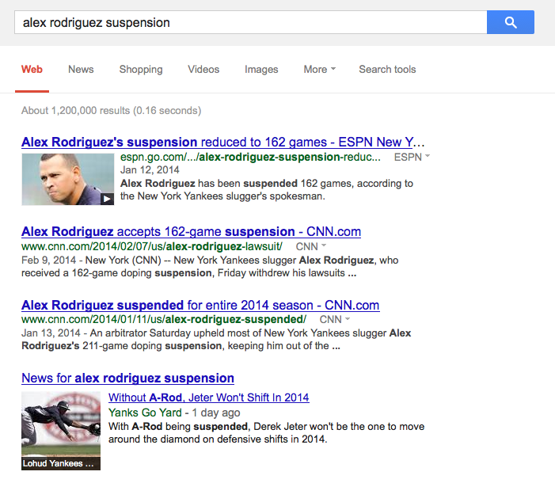
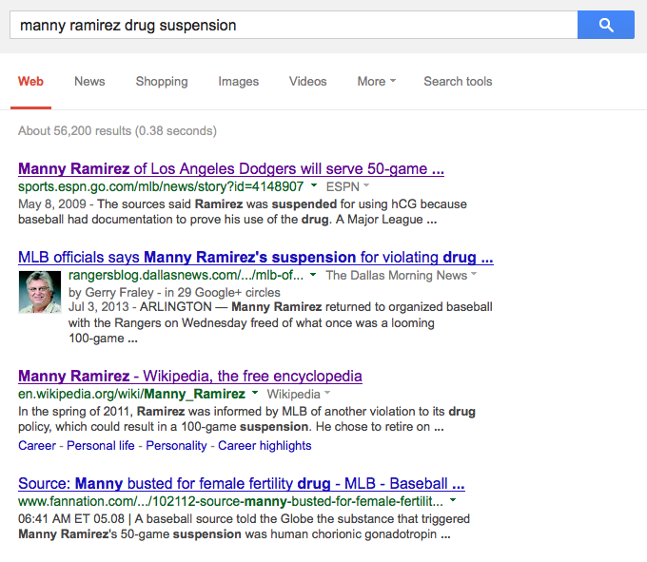
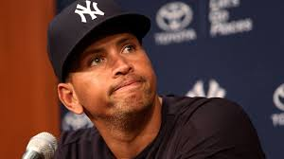
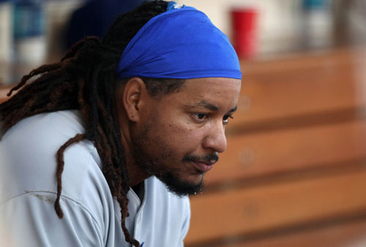
Extracting Salient Information About Events
information about players suspended for drug use
Notes:
A second motivation here.
Suppose you are trying to find information about players suspended for drug use.
If you know a few players who recently got suspended you can find documents that mention their suspensions.

Slide 6
Extracting Salient Information About Events
information about players suspended for drug use
Player | Drug | Ban | Team | Organization
Ramirez | hCG | 50 games | Dodgers | MLB
Rodriguez | PED | 162 games | Yankees | MLB
Armstrong | PED | for life | US Postal | USADA
… | … | … | … | …
Need knowledge about events!
Notes:
Again wouldn’t it be convenient to have this information in a structured format.
To extract this type of structured information you knowledge about suspension events in general -- ie. there is a player who gets suspended, there is a drug, there is a period of ban etc.

Slide 7

Question Answering
Building a system that can pass 4th Grade Exams!
A car skids along the road and smoke appears to be coming from under the tires. The heat that produces the smoke is caused by
(A) sound
(B) light
(C) friction
Need knowledge that can be used for inference!
Notes:
Here is another motivation.
If you are building a QA system that aims to pass 4th grade exam, you will run into questions like these, retrieval and matching techniques
alone aren’t adequate.
This type of a problem is central AI vision of achieving (if not exceeding) human-level performance on intelligence tasks.
To succeed, you need several forms of knowledge, especially in a form that can be used for inference.
Maybe I have convinced you that knowledge extraction is an useful pursuit.

Slide 8
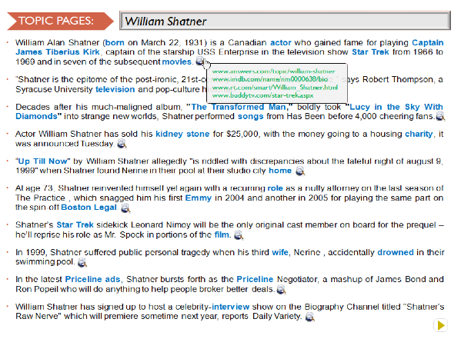
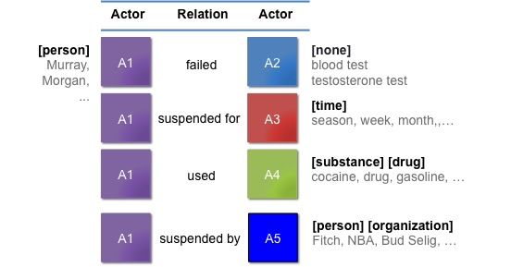

This Talk
Aspect Models for Topic Pages
Aggregate and organize information about entities.
2) Schemas for Event Extraction
Build models of open-domain events.
3) Knowledge Extraction for Question Answering
Answer 4th grade science exams.
Notes:
In this talk I am going to talk about three projects that broadly relate to knowledge extraction.
Extracting knowledge about events to serve as models of open-domain events.
Extracting knowledge about entities to automatically generate wikipedia-like pages.
Extracting and reasoning with knowledge for answering grade science exams.
I will spend most time on event schemas, a little bit of time on topic pages and I would like to mention on-going work in 3 and conclude with future directions.

Slide 9
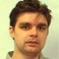
Aspect Models for Topic Pages
[CIKM 2009], [ICSC 2010]
Silviu Cucerzan
Microsoft Research

Slide 10
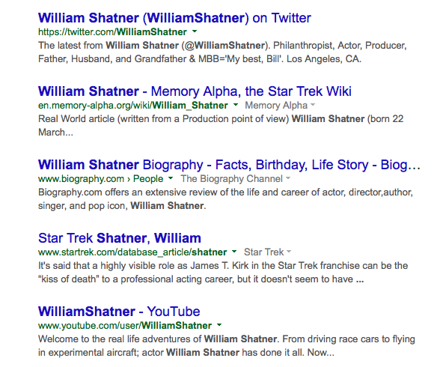
Organizing Information on Topics
Too much information
No high-level picture
Diverse aspects

Slide 11
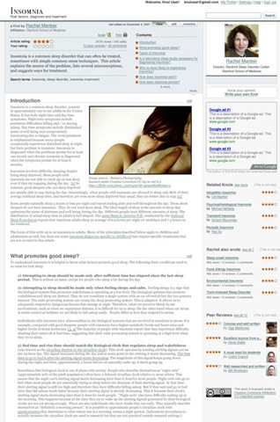
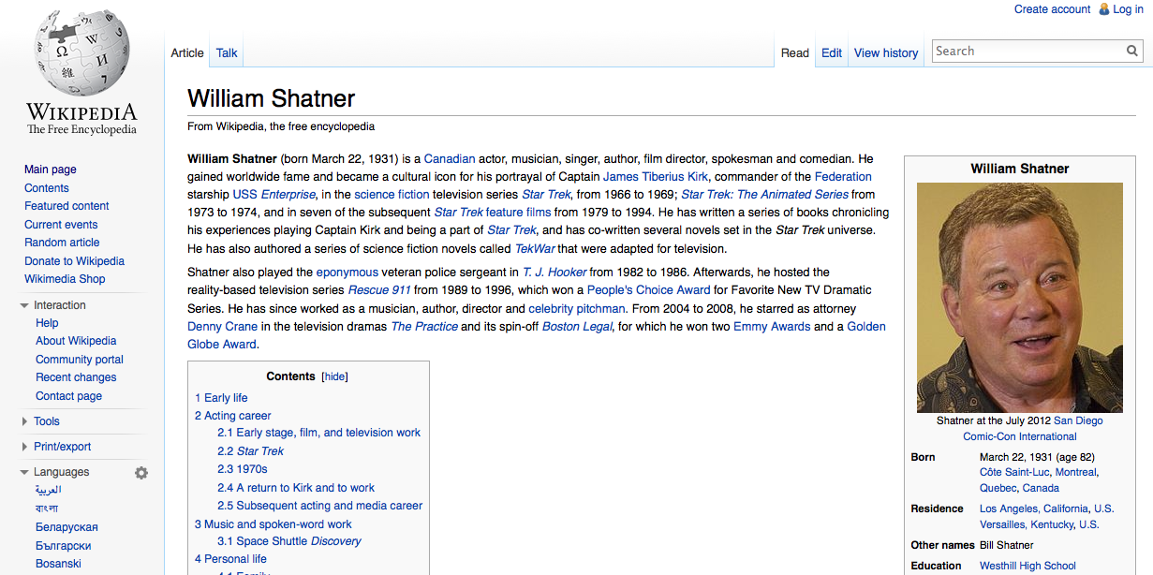
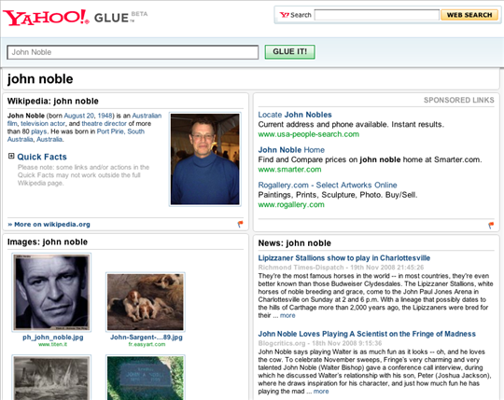
Manually Authored Solutions

Slide 12

Automatic Topic Pages
Automatically organize information on a topic.
William Shatner
1] In the latest Priceline ads, Shatner bursts forth as the Priceline Negotiator, a mashup of James Bond and Ron Popeil who will do anything to help people broker better deals.
2] Description William Alan Shatner (born on March 22, 1931) is a Canadian actor who gained fame for playing Captain James Tiberius Kirk, captain of the starship USS Enterprise in the television show Star Trek from 1966 to 1969 and in seven of the subsequent movies.
3] In 1999, Shatner suffered public personal tragedy when his third wife, Nerine , accidentally drowned in their swimming pool.
4] Shatner’s Star Trek sidekick Leonard Nimoy will be the only original cast member on board for the prequel – he’ll reprise his role as Mr. Spock in portions of the film.
5] On TV, Shatner made several guest appearances on The Practice and is featured in the spin-off series, Boston Legal, playing Denny Crane.
6] Decades after his much-maligned album, "The Transformed Man," boldly took "Lucy in the Sky With Diamonds" into strange new worlds, Shatner performed songs from "Has Been" before 4,000 cheering fans.
7] Actor William Shatner has sold his kidney stone for $25,000, with the money going to a housing charity, it was announced Tuesday.
8] William Shatner has signed up to host a celebrity-interview show on the Biography Channel titled "Shatner"s Raw Nerve" which will premiere sometime next year, reports Daily Variety.
9] Some of the best known actors of all time played on different episodes of the Twilight Zone, including William Shatner and Burgess Meredith.
10] Maybe that is William Shatner’s best birthday gift.
www.adweek.com/kaley-cuoco-and-william-shatner-team-pric..
www.hollywoodreporter.com/.../william-shatner
www.businessinsider.com/priceline-negotiator-kaley-cuo
…

Slide 13
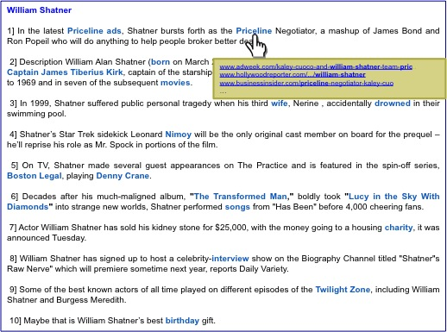
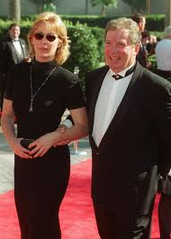
Approach
Salient Aspects
Relevant Sentences
Organize Sentences
Shatner acted in …
His book …
Shatner released albums …
As the negotiator in Priceline ads..
Nerine, his wife drowned in ….
Shatner was born in …
…
Challenges:
1) What are the key pieces of information to show?
2) How to find the information?
3) How to organize the information?

Slide 14
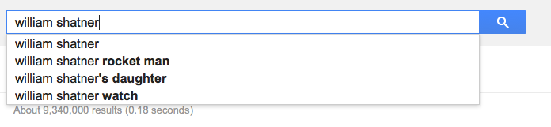
Query-log based aspect models
Query logs aggregate information needs about entities
Billions of search queries per day!
Temporally sensitive
Complementary to information in Wikipedia

Slide 15
Aspect Models
Specific – Direct queries
movie name, award, book…
Related – Similar entities
movies, music, albums…
senator, congressman,…
General – For all entities.
spouse, other relationships…
height, age, weight,…

Slide 16
Specific Aspects
Query Logs
William Shatner
William Shatner Star Trek
William Shatner Priceline
…
…
William Shatner wife
…
…
William Shatner albums
…
…
…
Aspects
Star Trek
Priceline
Wife
Albums
…
Frequently queried aspects.

Slide 17
Related Aspect Model
Aspects that are often queried for entities related to the query entity.
Query Entity
Related Entities
Specific Aspect Models
Related Aspect Model
…
…
…
actor
film
movie
wife
…
…
…
John Cusack
Joe Pesci
Scott Glen
…
…
…
…
Johnny Depp
…
…
…
…

Slide 18
Finding Related Entities
E is similar to Q if Aspects(E) is similar to Aspects(Q)
Computing similarity for all entities is expensive.
Billions of searches happen per day!

Slide 19
Finding Related Entities
Search Sessions
Candidate Related Topics
Johnny Depp
Pirates of the Caribbean
Johnny Depp
Nicolas Cage
Google
John Cusack
Walmart
Joe Pesci
Johnny Depp birthday
Pirates of the Caribbean
Nicolas Cage
Google
John Cusack
Walmart
Joe Pesci
….
Aspect model Similarity
Top Related Entities
Nicolas Cage movies
Nicholas Cage pics
…
Nicolas Cage actor
…
John Cusack
Joe Pesci
Denzel Washington
Scott Glen
Nicolas Cage
…
…
=
Johnny Depp actor
Johnny Depp pics
…
Johnny Depp movies
…

Slide 20
Retrieving and Organizing Sentences
IR techniques to retrieve and rank sentences.
Pseudo-relevance feedback to find typical sentence.
Classifier to remove ungrammatical and mal-formed web sentences.
Word-precedence to order sentences in a biographical timeline
Leverage Wikipedia biographies to learn word-precedence models.

Slide 21
Evaluation
Topic Pages vs. Search Results Summarization
400 Sentences for 20 Topics
Balasubramanian and Cucerzan, ICSC 2010

Slide 22
Summary
Automatically construct a topic page for entities using query log aspects.
Knowledge-driven content selection is useful for organizing information.
Query logs provide useful knowledge about entities.

Slide 23
This Talk
Aspect Models for Topic Pages
Aggregate and organize information about entities.
2) Schemas for Event Extraction
Build models of open-domain events.
3) Question Answering
Answer 4th grade science exams.
Notes:
In this talk I am going to talk about three projects that broadly relate to knowledge extraction.
Extracting knowledge about events to serve as models of open-domain events.
Extracting knowledge about entities to automatically generate wikipedia-like pages.
Extracting and reasoning with knowledge for answering grade science exams.
I will spend most time on event schemas, a little bit of time on topic pages and I would like to mention on-going work in 3 and conclude with future directions.

Slide 24
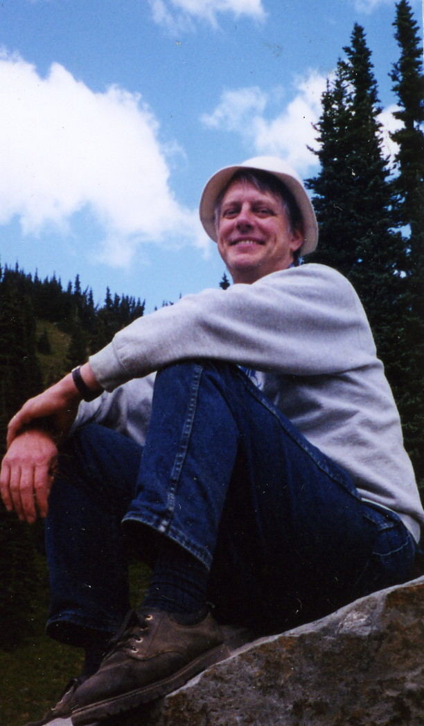
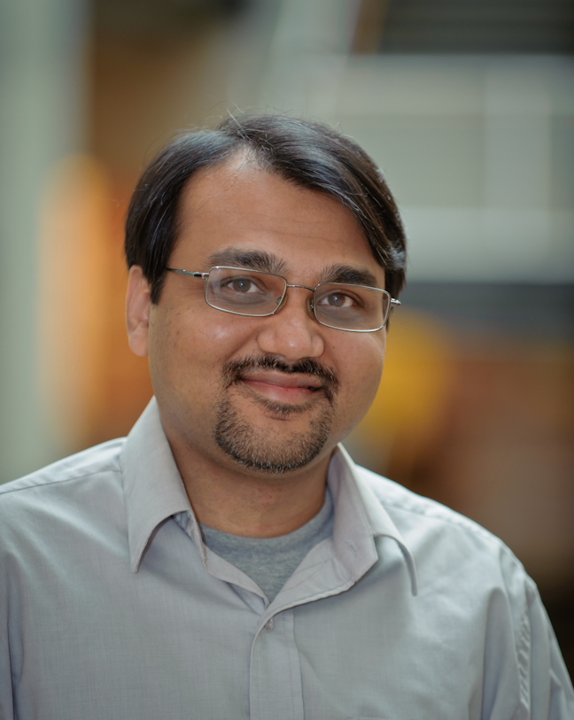
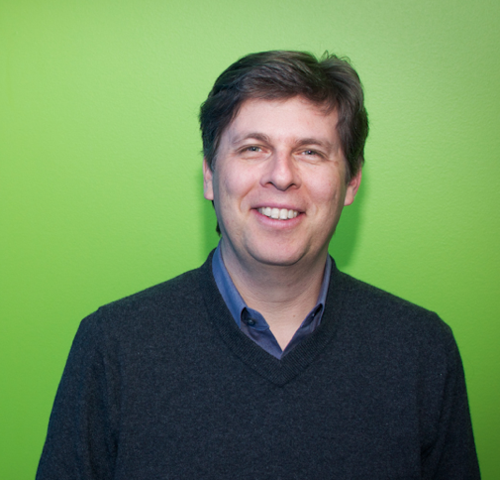
Generating Coherent Event Schemas
Rel-grams and Event Schemas
[AKBC-WEKEX 2012], [EMNLP 2013]
Stephen Soderland
University of Washington
Mausam
Indian Institute of Technology Delhi
Oren Etzioni
Allen Institute for Artificial Intelligence
Notes:
In this first part I am going to talk about joint work with Stephen Soderland, Mausam and Oren Etzioni.

Slide 25
Motivation
players suspended for drug use
Notes:
Getting back to the use case…
We are looking to find information about players suspended for drug use.
We get a bunch of web pages from a search engine. About 37000 for this one.

Slide 26
Motivation
players suspended for drug use
What can current information extraction systems do?
Player | Drug | Ban | Team | Organization
Ramirez | hCG | 50 games | Dodgers | MLB
Rodriguez | PED | 162 games | Yankees | MLB
Armstrong | PED | for life | US Postal | USADA
… | … | … | … | …
Notes:
Getting back to the use case…
We are looking to find information about players suspended for drug use.
We get a bunch of web pages from a search engine. About 37000 for this one.

Slide 27
Traditional Information Extraction
Extract semantic relationships between entities.
Manny Ramirez joined a growing lineup of All-Stars linked to drugs Thursday, with the dreadlocked slugger banished for 50 games by a sport that cannot shake free from scandal.
The Los Angeles Dodgers star said he did not take steroids and was prescribed medication by a doctor that contained a banned substance.
"It's a dark day for baseball and certainly for this organization," Dodgers general manager Ned Colletti told reporters on the field at Dodger Stadium. "This organization will never condone anything that isn't clean."
The commissioner's office didn't announce the specific violation by the 36-year-old outfielder, who apologized to the Dodgers and fans for "this whole situation."
However, testing by Major League Baseball showed that Ramirez had testosterone in his body that was not natural and came from an artificial source, two people with knowledge of the case told ESPN's Mark Fainaru-Wada and T.J. Quinn. The sources said that in addition to the artificial testosterone, Ramirez was identified as using the female fertility drug human chorionic gonadotropin, or hCG.
The sources said Ramirez was suspended for using hCG because baseball had documentation to prove his use of the drug. A Major League Baseball source said Ramirez's representatives indicated they would fight a suspension for using artificial testosterone.
Ramirez, in a statement issued by the players' union, said: "Recently, I saw a physician for a personal health issue. He gave me a medication, not a steroid, which he thought was OK to give me.
…
Traditional IE
Employee(Ned Colletti, Dodgers)
Employee(Mark Fainaru-Wada, ESPN)
Employee(TJ Quinn, ESPN)
Located-at(Ned Colletti, Dodger’s stadium)
…
Relations need to be hand-specified!
Notes:
Traditional Information Extraction systems aim to identify semantic relationships between entities such as “Employed by” and “located at”.
The trouble is we have to hand-specify these relations a-priori. The approach does not scale well if we want to switch to another domain.

Slide 28
Open Information Extraction
Extract arbitrary relationships between noun phrases.
Manny Ramirez joined a growing lineup of All-Stars linked to drugs Thursday, with the dreadlocked slugger banished for 50 games by a sport that cannot shake free from scandal.
Open IE
(Manny Ramirez, joined, a growing lineup of All-stars)
(dreadlocked slugger, was banished for, 50 games)
(dreadlocked slugger, was banished by, a sport)
Notes:
Open Information extraction aims to address the scale issue.
It can identify open-domain relationships mentioned in text.
Typically, relations are expressed as(Arg1, Relation, Arg2) formatted triple.
For example, this sentence yields three relation triples, which relate to
This scales well and can generate relations in many domains.

Slide 29
Open Information Extraction
Relations between noun-phrases.
Argument 1 | Relation | Argument 2
Manny Ramirez | joined | a growing lineup of All-Stars
the dreadlocked slugger | was banished by | a sport that cannot shake free from scandal
the dreadlocked slugger | was banished for | 50 games
Los Angeles Dodgers star | said of | he
he | did was prescribed medication by | a doctor that contained a banned substance
he | did not take | steroids
he | did was prescribed | medication
Dodgers general manager Ned Colletti | told reporters on | the field
Dodgers general manager Ned Colletti | told reporters at | Dodger Stadium
reporters | was told on | the field
Dodgers general manager Ned Colletti | told | reporters
This organization | will never condone | anything that is n't clean
reporters | was told at | Dodger Stadium
Ned Colletti | was manager of | Dodgers
It | 's certainly | a dark day
The commissioner 's office | didn't announce specific violation by | the 36-year-old outfielder… this whole situation
the 36-year-old outfielder | apologized to | the Dodgers and fans
the specific violation | did n't announce by | the 36-year-old outfielder …this whole situation
The commissioner 's office | did n't announce | the specific violation
Ramirez | had testosterone in | his body that was not natural
Ramirez | was identified in | addition
testosterone | was had in | …came from an artificial source
his body that was not natural | came from | an artificial source
Ramirez | had | testosterone
two people | told | ESPN 's Mark Fainaru-Wada
testing | However showed | Ramirez
Ramirez | had testosterone | two people
they | would fight | a suspension
Too many relations!
Notes:
However, it extracts too many relationships. Open Ie will output all relations it finds in texts.

Slide 30
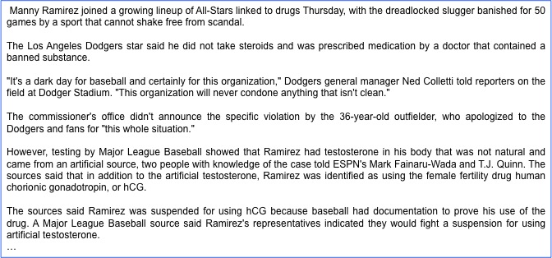
Event Extraction using Templates
Player | Drug | Ban | Team | Organization
Ramirez | hCG | 50 games | Dodgers | MLB
Template IE
Suspension Template
Actors Roles
Player Person who fails the test
Drug Drug used by the player
Ban Time for which the player is suspended
Team Player’s team
Organization Organization that suspends the player

Slide 31
Will this scale?
How to generate schemas for arbitrary open-domain events?
bombing
Test Drug test that was administered
Player Person who fails the test
Team Player’s team
Organization Organization that suspends the player
Drug Drug used by the player
Duration Time for which the player is suspended
Lawsuit
Test Drug test that was administered
Player Person who fails the test
Team Player’s team
Organization Organization that suspends the player
Drug Drug used by the player
Duration Time for which the player is suspended
Arrest
Test Drug test that was administered
Player Person who fails the test
Team Player’s team
Organization Organization that suspends the player
Drug Drug used by the player
Duration Time for which the player is suspended
Suspension
Actors Roles
Test Drug test that was administered
Player Person who fails the test
Team Player’s team
Organization Organization that suspends the player
Drug Drug used by the player
Duration Time for which the player is suspended
Prior Work
Manual and limited to a small number of domains
Automatic method resulted in incoherent schemas.
[Chambers and Jurafsky, 2009]

Slide 32

Our Goal
Generate coherent open-domain schemas about events mentioned in a corpus.
Input: News Texts
Output: Event Schemas
bombing
Test Drug test that was administered
Player Person who fails the test
Team Player’s team
Organization Organization that suspends the player
Drug Drug used by the player
Duration Time for which the player is suspended
Lawsuit
Test Drug test that was administered
Player Person who fails the test
Team Player’s team
Organization Organization that suspends the player
Drug Drug used by the player
Duration Time for which the player is suspended
Arrest
Test Drug test that was administered
Player Person who fails the test
Team Player’s team
Organization Organization that suspends the player
Drug Drug used by the player
Duration Time for which the player is suspended
Suspension
Actors Roles
Test Drug test that was administered
Player Person who fails the test
Team Player’s team
Organization Organization that suspends the player
Drug Drug used by the player
Duration Time for which the player is suspended

Slide 33
Event Schemas
A set of actors and the roles they participate in.
Actor
Relation
Actor
[person]
Murray,
Morgan,
...
A1
A2
[none]
blood test
testosterone test
failed
A1
A3
[time]
season, week, month,,…
suspended for
A1
A4
[substance] [drug]
cocaine, drug, gasoline, …
used
A1
A5
[person] [organization]
Fitch, NBA, Bud Selig, …
suspended by
1) Not labeled actors.
2) Roles via relations.
Notes:
Many actors and useful relations.

Slide 34
Observations
Facts co-mentioned in text likely belong to the same event or scenario.
Open IE relations present a succinct representation of facts.
John was arrested by police … They charged him with armed robbery
Ramirez failed a drug test … He was suspended for 50 games
A bomb exploded in a market … The group claimed responsibility.
Democrats favored the bill … The bill was overwhelmingly opposed by the republicans
(John, was arrested by, police) … (They, charged him with, armed robbery)
(Ramirez, failed, a drug test) … (He, was suspended for, 50 games)
(A bomb, exploded in, a market) … (The group claimed responsibility)
(Democrats, favored, the bill) … (The bill, was overwhelmingly opposed by, the republicans)

Slide 35
Our Solution
Use Open IE relations to generate schemas!
Input: News Texts
Output: Event Schemas
Open IE Relations
Relational Co-occurrence
(Rel-grams)

Slide 36
Representing Relations
Text:
He cited a new study that was released by UCLA in 2008.
Extractions:
(He, cited, a new study)
(a new study, was released by, UCLA)
(a new study, was released in, 2008)
Normalized:
(he, cite, study)
(study, be released by, UCLA)
(study, be released in, 2008)
Generalized:
([person], cite, [activity])
([activity], be released by, [organization])
([activity], be released in, [time-unit])
Ollie [Mausam et al, 2012]
State-of-the-art open extractor.
Extract Argument Head:
10 people => people
group of passengers => passengers
France’s president => president
Assign Semantic Classes
Named entity classes
Person, Organization, Location,…
29 WordNet classes
Drug, Structure, Device, Activity, …

Slide 37
Rel-grams – A model of relation co-occurrence
How likely are we to see relation T’ in the vicinity of T?
Probability of seeing T’ in the vicinity of T
Delta-smoothed for sparse events.
Importance decays with length of window
Notes:
We formalize this intuition using a simple bi-gram co-occurrence model of relations.

Slide 38
Rel-grams Tabulation
Rel-grams Tabulation
T | T’ | #1(T, T’) | #2(T, T’)
(he, cited, study) | (study, be released by, UCLA) | 1 | 2
([person], cited, [activity]) | ([activity], released by, [organization]) | 17 | 19
([person], cited, X:[activity]) | (X:[activity], released by, [organization]) | 14 | 14
… | … | … | …
(X:[person], failed, test) | (X:[person], suspended for, [activity]) | 23 | 24
(bomb, exploded in, Bhagdad) | (group, claimed, responsibility) | 1 | 7
([device], exploded in, [location]) | ([organization], claimed, responsibility) | 14 | 11

Slide 39

Implementation
1.8 Million New York Times Articles
~ 1.1 Million Rel-grams
T | T’ | #1(T, T’) | #2(T, T’)
(he, cited, study) | (study, be released by, UCLA) | 1 | 2
([person], cited, [activity]) | ([activity], released by, [organization]) | 17 | 19
([person], cited, X:[activity]) | (X:[activity], released by, [organization]) | 14 | 14
… | … | … | …
([device], exploded in, [location]) | ([organization], claimed, responsibility) | 14 | 11
12 node
cluster
Co-reference
Resolver
Open Information Extractor
Rel-grams
Emitter
Rel-grams
Counter
Map
> 55 Billion Relation Pairs
Reduce

Slide 40
Do Rel-grams capture useful knowledge?
(a) Does T entail T’ or T’ entail T in the real world?
If you knew that : ([device], exploded in, [location]),
would you expect? : ([organization], claimed, responsibility)
or vice versa.
Manual evaluation showed Rel-grams capture useful event knowledge.
74% of Rel-grams are valid. i.e., 26% extraction errors
83% of the valid Rel-grams are entailments
90% of the valid Rel-grams have the same topic.
(b) Do T and T’ capture information on the topic of an single event?
Is Topic (T) = Topic (T’)

Slide 41
Building Schemas
T | T’ | #1(T, T’) | #2(T, T’)
(he, cited, study) | (study, be released by, UCLA) | 1 | 2
([person], cited, [activity]) | ([activity], released by, [organization]) | 17 | 19
([person], cited, X:[activity]) | (X:[activity], released by, [organization]) | 14 | 14
… | … | … | …
(X:[person], failed, test) | (X:[person], suspended for, [activity]) | 23 | 24
(bomb, exploded in, Bhagdad) | (group, claimed, responsibility) | 1 | 7
([device], exploded in, [location]) | ([organization], claimed, responsibility) | 14 | 11
bombing
Test Drug test that was administered
Player Person who fails the test
Team Player’s team
Organization Organization that suspends the player
Drug Drug used by the player
Duration Time for which the player is suspended
Lawsuit
Test Drug test that was administered
Player Person who fails the test
Team Player’s team
Organization Organization that suspends the player
Drug Drug used by the player
Duration Time for which the player is suspended
Arrest
Test Drug test that was administered
Player Person who fails the test
Team Player’s team
Organization Organization that suspends the player
Drug Drug used by the player
Duration Time for which the player is suspended
Suspension
Test Drug test that was administered
Player Person who fails the test
Team Player’s team
Organization Organization that suspends the player
Drug Drug used by the player
Duration Time for which the player is suspended

Slide 42
Rel-grams to Schemas
Schemas correspond to sets of relations that co-occur.
T | T’ | #1(T, T’) | #2(T, T’)
(he, cited, study) | (study, be released by, UCLA) | 1 | 2
([person], cited, [activity]) | ([activity], released by, [organization]) | 17 | 19
([person], cited, X:[activity]) | (X:[activity], released by, [organization]) | 14 | 14
… | … | … | …
(X:[person], failed, test) | (X:[person], suspended for, [activity]) | 23 | 24
(bomb, exploded in, Bhagdad) | (group, claimed, responsibility) | 1 | 7
([device], exploded in, [location]) | ([organization], claimed, responsibility) | 14 | 11
Relation graph.
Find Seeds
Personalized PageRank

Slide 43
System Output
Actor
Relation
Actor
[person]
Murray,
Morgan,
...
A1
A2
[none]
test
failed
A1
A3
[time]
season, week, month,,…
suspended for
A1
A4
[substance] [drug]
cocaine, drug, gasoline, …
used
A1
A5
[game] [activity]
violation, game, abuse, …
suspended for
A1
A6
[location]
desert, Simsbury, Albany, …
was in
A1
A7
[person] [organization]
Fitch, NBA, Bud Selig, …
suspended by
Notes:
Many actors and useful relations.

Slide 44
Coherence Issue in Prior Work
Actor
Relation
Actor
infection
fire
A1
A2
disease
caused
disease
A2
A1
infection
fire
spread
infection
fire
A1
broke out
extinguished
A1
infection
fire
Notes:
… of infection spreading and fire spreading.
What is wrong with mixing distinct events?
Relations that don’t fit in one event.
Example: extinguishing doesn’t fit infection event.
Can result in triples that make no sense (disease, spread, fire)
There are plenty of other examples:
airlines scheduling flights,
government scheduling meetings,
nba, scheduling games
Why does this happen

Slide 45
Evaluating Schemas
Prior automatic method [Chambers and Jurafsky, 2009]
Relation Coherence
1) Are the relations in a schema valid?
2) Do the relations belong to the schema topic?
Actor coherence:
3) Do the actors have a useful role within the schema?
4) What fraction of instances fit the role

Slide 46
Results
More coherent sets of relations and actors!
Percentage
Differences are statistically significant.
Balasubramanian et al., EMNLP 2013

Slide 47
Summary
Developed a fully automatic method for discovering event schemas.
Scales to arbitrary domains.
Improved coherence compared to prior state-of-the-art.
Released a set of 2K schemas that were mined from New York Times.
Released a set of 1.1 Million Rel-grams.

Slide 48
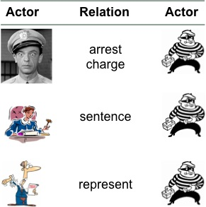
This Talk
Aspect Models for Topic Pages
Aggregate and organize information about entities.
2) Schemas for Event Extraction
Build models of open-domain events.
3) Question Answering
Answer 4th grade science exams.
Notes:
In this talk I am going to talk about three projects that broadly relate to knowledge extraction.
Extracting knowledge about events to serve as models of open-domain events.
Extracting knowledge about entities to automatically generate wikipedia-like pages.
Extracting and reasoning with knowledge for answering grade science exams.
I will spend most time on event schemas, a little bit of time on topic pages and I would like to mention on-going work in 3 and conclude with future directions.

Slide 49


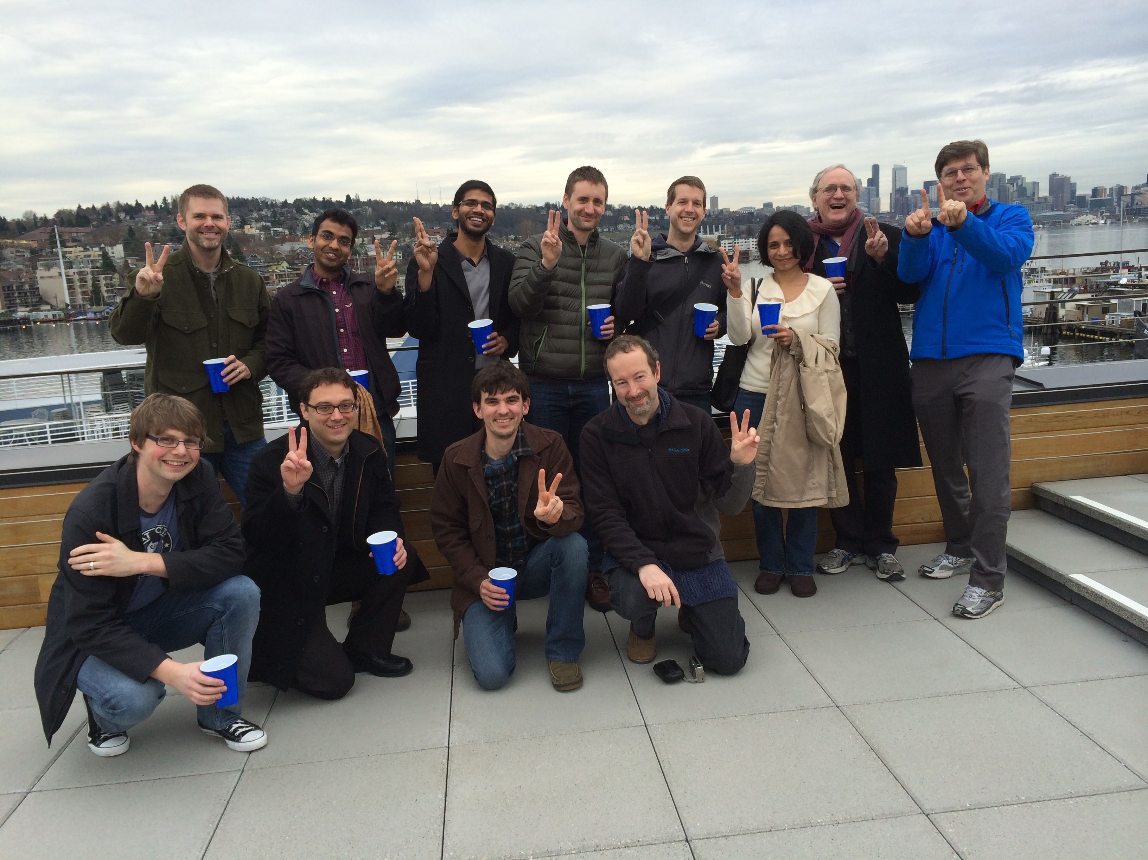

Question Answering
[On-going work]
Joint work with:
Notes:
In this second part, I am going to talk about on going work at AI2, where I co-lead the design and development of a QA system that can answer grade level science exams.
We are used externally published standardized exams w/ increasing levels of sophistication in knowledge and reasoning.

Slide 50
4th Grade Science Questions
One hot, summer day it rained very heavily. After the rain, a plastic pan on a picnic table had 2 cm of rainwater in it. Four hours later, all the rainwater in the pan was gone.
Which process caused the rainwater in the pan to disappear as it sat
outside in the hot air?
A condensation
B evaporation
C precipitation
D erosion
If the day were cool instead of hot, the rainwater in the pan would have
disappeared
A slower
B faster
C in the same amount of time
Definition
Qualitative relationship
Notes:
Multiple choice questions
-- easy, well relatively easy to evaluate
-- explainable
Externally published standardized exams w/ increasing levels of sophistication in knowledge and reasoning.
NY state regents exams.

Slide 51
Keyword Matching alone isn’t adequate.
Which example describes an organism taking in nutrients?
(A) a dog burying a bone
(B) a girl eating an apple
(C) an insect crawling on a leaf
(D) a boy planting tomatoes in a garden
Question
A boy planting tomatoes in a garden describes an organism taking in nutrients
Matching Sentence
The roots of the plant take in water and nutrients.

Slide 52
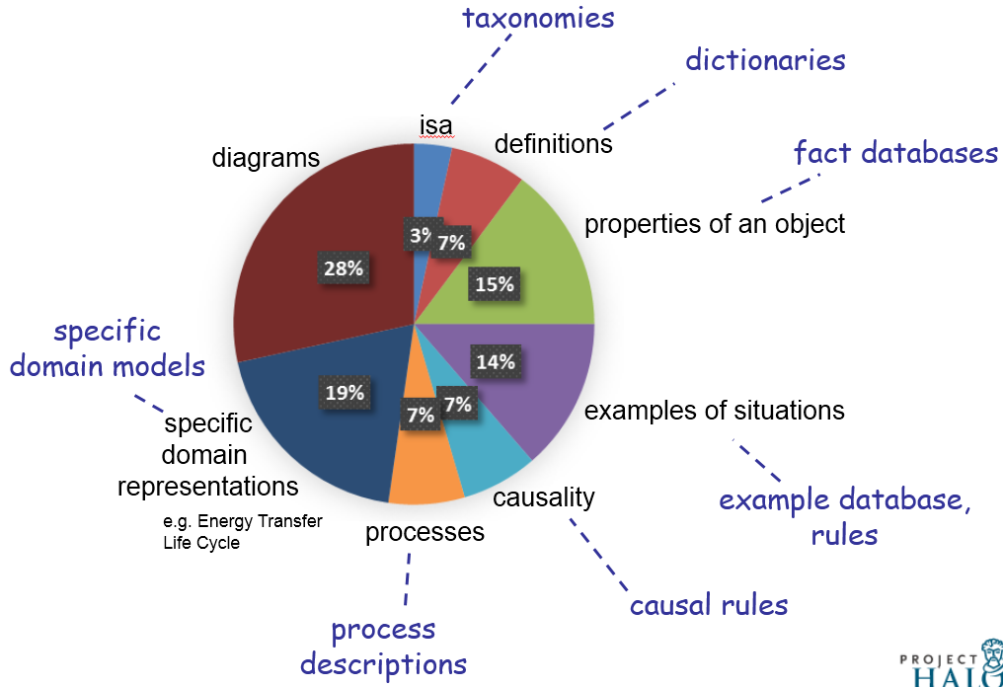
4th Grade Knowledge Requirements
[AKBC-WEKEX, 2013]
Notes:
So what does it take to pass this exam?
Diagram understanding.
Simple taxonomic knowledge such as isa, definitions,
properties of object (ice is solid),
examples of situations (organism taking in nutrients),
Higher-order relations
causality (gravity / causes / objects to fall to the ground),
function
requirements
enablement
process descriptions (sweat / moistens/ skin) (cool air/ against/ wet skin) cools (animal)
domain models (predator eats prey, predators go up, prey go down)

Slide 53
Our Approach
Extract knowledge through machine-reading of texts and existing sources.
Study guides
Web texts
Definitions
Multiple reasoning methods.
Text-based reasoning (e.g., structured matching)
Semi-formal deduction using text-based propositions.
Probabilistic deductive reasoning in First-order-logic.
Current focus
Notes:
So what does it take to pass this exam?
Diagram understanding.
Simple taxonomic knowledge such as isa, definitions,
properties of object (ice is solid),
examples of situations (organism taking in nutrients),
Higher-order relations
causality (gravity / causes / objects to fall to the ground),
function
requirements
enablement
process descriptions (sweat / moistens/ skin) (cool air/ against/ wet skin) cools (animal)
domain models (predator eats prey, predators go up, prey go down)

Slide 54
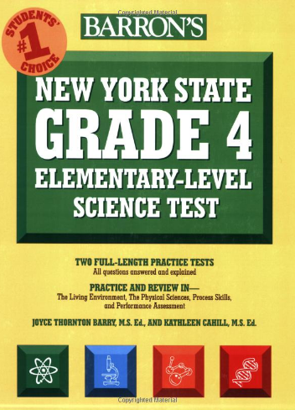
Machine-reading to Extract Knowledge
WordNet
Open IE
Patterns over Study Guide

Slide 55
Answering Questions using Knowledge
Question Interpretation
Reasoning using retrieved knowledge
Study
guide
Web
Defns
Cause/Effect
Action/Purpose
Taxonomic
…
Knowledge

Slide 56
Question Interpretation
Which example describes an organism taking in nutrients?
(A) a dog burying a bone (B) a girl eating an apple (C) an insect crawling on a leaf
(D) a boy planting tomatoes in a garden
Assertion
a girl eating an apple describes an organism taking in nutrients
Question Relation
[girl eat apple] EXAMPLE [organism take in nutrients]

Slide 57
Retrieving Supporting Evidence
Question Relation
[girl eat apple] EXAMPLE [organism take in nutrients]
Evidence
[animals eat] EFFECT [animals get nutrients]
Animals must eat in order to get nutrients.
[cow eating grass] EXAMPLE [animal eating plants]
Cow eating grass is an example of an animal eating plants.
…

Slide 58
Matching as Reasoning
Question Relation
[girl eat apple] EXAMPLE [organism take in nutrients]
Problem Statement
Known:
To Determine:
[girl eat apple] [organism take in nutrients]
girls ISA animal
animal ISA organism
Evidence
[animals eat] [animals get nutrients]
EFFECT
Relation

Slide 59
4th Grade Science Exam Results
Passing Grade (65)
Accuracy
Haven’t passed yet!

Slide 60
Summary
Question answering to pass grade-level exams is challenging.
Requires a wide variety of knowledge
Requires a range of reasoning methods.
An exciting pursuit for AI research!

Slide 61
Future Directions

Slide 62
Reasoning with Automatically Extracted Knowledge
To Prove: Iron nail is a conductor of electricity.
Evidence: Metals are excellent conductors of electricity and heat.
Deductive Reasoning
To prove:
iron-nail(n) => conductor(n, y) ^ electricity(y)
Known:
[Property of metals]
E1: metal(x) => conductor(x, y) ^ electricity(y)
[Compound noun relationship]
E2: iron-nail(x) => made-of(x, iron)
[Transfers-through rule]
E3: made-of(x, iron) => iron(x)
[ISA]
E4: iron(x) => metal(x)
iron nail is made of iron + iron is a metal
+ metals are conductors of electricity
=> iron nail is a conductor of electricity

Slide 63
Challenges in Reasoning
Deep vs. Shallow Trade-off
Representation
Extraction
Reasoning
Reasoning power
Extraction difficulty
Handling gaps
Hybrid mechanism with deep reasoning as much as possible
Shallow as back-off for robustness.

Slide 64

Information Retrieval and Mobile Search
How can knowledge help effective and efficient access to information?
Using schemas for event retrieval.
Semantic representations.
Search for all your information
in all devices.
FindAll 2.0
[CoNext 2012]
Knowledge-driven one-shot responses.

Slide 65
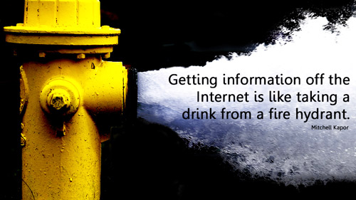
Conclusion
Open-domain knowledge extraction
1) Distill the vast amounts of information online.
2) Perform reasoning to accomplish human-level performance on AI tasks.

Slide 66
Thanks. Talk to me if any of these interest you!
Event Schemas
[EMNLP 2013]
Information Retrieval
Predicting Search Quality
Information
Extraction
Rel-grams
[AKBC 2012]
Topic Pages
[CIKM 2009]
[ICSC 2010]
Query Reduction
[SIGIR 2010]
Performance Prediction
[SIGIR 2010]
FindAll
[CoNext 2012]
TailEnder
[IMC 2009]
Mobile Systems
Energy efficient search on phones.
Notes:
I am interested in Information retrieval, extraction and the intersection of IR and mobile systems. retrieval.
In the intersection of information retrieval and mobile systems I have done work on energy efficient search from mobile phones.
In information extraction I have worked on automatically extracting knowledge about events.

Slide 67
Future Work
Extracting Richer Knowledge Forms
Photosynthesis is a process used by plants to convert light energy, normally from the sun, into chemical energy that can later used to fuel the organism’s activities.
occurs in
sun
photosynthesis
plant [organism]
source
input
output
source
agent
convert to
light energy
chemical energy
activities
Challenges:
Implicit relations
Reference resolution
Aggregating information from multiple sentences

Slide 68
In context
Open Event Extraction
Acquisition
Research study
Legislation
Open Domain
Open Event Schemas
[EMNLP 2013]
[AKBC-WEKEX 202]
Open Relation Extraction
is an album by,
has a Ph.D. in,
made a promise to,…
Fine-grained
Actor, Architect, …
Airline, Sports team, …
City, Country, mountain, ….
Template-based Extraction
Bombing
Arrest
Arson
…
Traditional IE
acquired-by
employed-by
president-of
…
Named-entities
Person
Organization
Location
Misc.
Small Domains
Entities
Relations
Events
Notes:
Well studied problem.
Several successful systems and products exist.
Mostly supervised methods.

Slide 69
Future Work
Graph-based
AMR
Probabilistic Inference + FOL
BLUE
First-order logic
Tuples
Variablized Rules
Propositional logic
Tuple Rules
Phrasal Rules
metal(x) => conductor(x, Electricity)
substance(x, metal) => metal(x)
Inference
Textual Re-write Rules
Targeted IE
animal eat => animal get nutrients
(animal, eat, _) => (animal, get, nutrients)
Alignment + Matching
Open IE
Matching
BOW
No Rules
Lexical + Relations
IF-THEN rules
Variablized Rules
Semantic
Representation
Notes:
Finally, we would like to use more formal reasoning where possible.
For example we could extract rules in FOL from text.
if x is a metal then x is a conductor of electricity.
This requires extracting rules that require variablized representation of entities. etc.
And then there are deeper formalisms that involve representing the semantics of each verb tied to a particular ontology
Advances are making this the right time to pursue these efforts.

Slide 70
Future Work
Reasoning with automatically extracted knowledge
To Prove: Animals get energy for growth from food.
Evidence: Eating a variety of the right types of food provides energy for
growth and activity.
Graph-based Reasoning
Known
To Determine
get
provide
energy
animal
energy
food
eat
purpose
purpose
growth
?x
food
growth

Slide 71
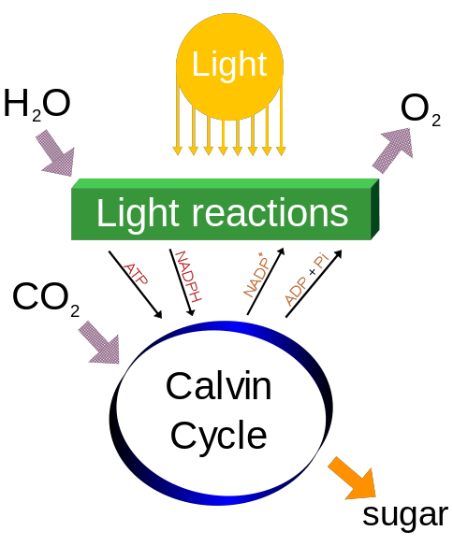
Future Work – Extracting Richer Structures
Photosynthesis
Inputs : H₂O, CO₂
Outputs : O_{2,} sugar
Energy source : sunlight
Sub-Events : Light Reactions
Sub-Process : Calvin Cycle
Calvin Cycle
Inputs : CO2, ATP, NADPH
Outputs : NADP+, ADP+, Ph
Energy source : sunlight
Sub-Events : Light Reactions
Sub-Process : Calvin Cycle

Slide 72
Future Directions
Knowledge extraction toward richer structures.
Scripts with causal and temporal links.
Processes with I/O, actors, and their relations.
Extracting implicative (IF-THEN) rules from text.
Applications
Building extractors for Open event schemas.
Apply event knowledge to improve co-reference.
Schemas for single-document summarization
Information Extraction
Bootstrapping from high-precision models of phenomena
-- Schema relations as a starting point for building extractors.
-- Explicit causal and temporal links to detect implicit links
Application driven development.

Slide 73
Future Directions
Reasoning with automatically extracted knowledge
Handle gaps and uncertainty via probabilistic methods.
Combining robust shallow methods with formal reasoning.
Broad-coverage methods for bridging gaps in knowledge.
Applications
Question answering
Knowledge-based population
Common-sense reasoning
Information Extraction
Develop mechanisms that help identify what is missing.
Feature-based entailments lack explanatory powers
Find balance between extraction difficulty vs. reasoning complexity.
Formal representations ease reasoning but are also harder to extract.

Slide 74
Future Directions
Semantic representations for Information Retrieval
Previous extraction techniques did not scale.
Open Information Extraction does!
Facilitating information access in Mobile devices
Knowledge-driven retrieval and organization
Pro-active solutions for improving access to content.
Information Retrieval
Mobile
Systems

Slide 75
Future Work
Deductive
Metal fork is made of metal + metals conduct electricity.
=> Metal fork conducts electricity.
Abductive Reasoning
Car skids on road. Smoke is produced under the tires.
What generated the heat that produced the smoke?
Qualitative Reasoning with domain models
If predator population increases then prey population will decrease.
If temperature increases evaporation rate increases.
Diagrammatic Reasoning

Slide 76
Future Work
Propositional logic
Tuple Rules
Phrasal Rules
Inference
Textual Propositions
Targeted IE
animal eat => animal get nutrients
(animal, eat, _) => (animal, get, nutrients)
Alignment + Matching
Open IE
Matching
BOW
No Rules
Lexical + Relations
IF-THEN rules
Representation
Notes:
We have begun to use some of these relations as text-based “propositional” rules.
For e.g. animal eat => animal get nutrients.
Then we can do inference in prop.logic.
However because the propositions are textual we have a mismatch problem.
We are exploring combining matching based approaches

Slide 77
Future Work
Graph-based
AMR
Probabilistic Inference + FOL
BLUE
First-order logic
Tuples
Variablized Rules
Propositional logic
Tuple Rules
Phrasal Rules
metal(x) => conductor(x, Electricity)
substance(x, metal) => metal(x)
Inference
Textual Re-write Rules
Targeted IE
animal eat => animal get nutrients
(animal, eat, _) => (animal, get, nutrients)
Alignment + Matching
Open IE
Matching
BOW
No Rules
Lexical + Relations
IF-THEN rules
Variablized Rules
Semantic
Representation
Notes:
Finally, we would like to use more formal reasoning where possible.
For example we could extract rules in FOL from text.
if x is a metal then x is a conductor of electricity.
This requires extracting rules that require variablized representation of entities. etc.
And then there are deeper formalisms that involve representing the semantics of each verb tied to a particular ontology
Advances are making this the right time to pursue these efforts.

Slide 78
Sample Rel-grams
T | T’ | Valid? | Relation?
(lawsuit, be file by, X) X : [organization] X = union, Trust Insurance co., .. | (Y, to hear, argument) Y : [person] Y = judge | Yes | Entails
(lawsuit, be file by, X) X company, Powers, … | (X, be base in, Y) Y = {Washington, Kansas City, …} | Yes | Topic
(lawsuit, be file by, X) X = {union, Trust Insurance co., ..} | (Y, be for, comment) Y = {official, Officials, Oliver} | No | None

Slide 79
Rel-grams Evaluation
A sample of 1500 Rel-grams from the Top 10%
Percentage
A large proportion of Rel-grams carry useful information about events.
Balasubramanian et al., EMNLP 2013
Notes:
Tuple validity is a problem:
Open IE is about 75% accurate.
Rel-gram the errors multiply!
Strong implication results show there is a signal here.

Slide 80
Finding Related Tuples
Create a graph from Rel-grams
Nodes = Generalized tuples
Edge = Symmetric conditional probability
Use high connectivity nodes as seeds.
Centrality indicates salience.

Slide 81
Retrieving Sentences
For a given topic and an aspect which sentence to pick?
Topic: Adrien Brody
Aspect: The Pianist
After The Pianist Brody has appeared in four very different movies.
Adrien Brody, best known for his Oscar-winning performance in “The Pianist,” was in the audience Friday at the opening.
2008 Academy Award winner Rachel Weisz (The Constant Gardener), Academy Award winner Adrien Brody (The Pianist), Mark Ruffalo (Zodiac), and Academy Award nominee ...
Adrien Brody received widespread recognition when he was cast as the lead in Roman Polanski’s The Pianist (2002).
Adrien Brody is a New York actor who is known to international audiences as the star of Roman Polanski’s 2002 film, The Pianist.
Notes:
Standard IR techniques to enhance the asepc

Slide 82
Retrieving Sentences
Find the typical relationship between the topic and aspect.
Topic: Adrien Brody
Aspect: The Pianist
After The Pianist Brody has appeared in four very different movies.
Adrien Brody, best known for his Oscar-winning performance in “The Pianist,” was in the audience Friday at the opening.
2008 Academy Award winner Rachel Weisz (The Constant Gardener), Academy Award winner Adrien Brody (The Pianist), Mark Ruffalo (Zodiac), and Academy Award nominee ...
Adrien Brody received widespread recognition when he was cast as the lead in Roman Polanski’s The Pianist (2002).
Adrien Brody is a New York actor who is known to international audiences as the star of Roman Polanski’s 2002 film, The Pianist.
….
Aspect Context Model
actor 0.3
star 0.2
win 0.2
film 0.2
2002 0.1
…
Notes:
Standard IR techniques to enhance the asepc

Slide 83
Building Schemas from Related Tuples
Extract actors from arguments.
Use equality constraints.
Merge candidates that share the same relation.
Use type compatibility rules.
Tuples | Page Rank
[person], suspended by, [org] | 1.0
[person], used, [substance] | 0.9
[person], suspended for, [activity] | 0.8
[person], failed, test | 0.7
… | …
Ramirez, used, [substance] | 0.3
… | …
… | …
Tuples | Page Rank
A1: [person], suspended by, A2: [org] | 1.0
A3: [person], used, A4: [substance] | 0.9
A5: [person], suspended for, A6: [activity] | 0.8
A4: [person], failed, A7:test | 0.7
… | …
A8: Ramirez, used, A9: [substance] | 0.3
… | …
… | …
Tuples | Page Rank
A1: [person], suspended by, A2: [org] | 1.0
A1: [person], used, A4: [substance] | 0.9
A1: [person], suspended for, A6: [activity] | 0.8
A1: ([person], failed, A7:test) | 0.7
… | …
A1: Ramirez, used, A4: [substance] | 0.3
… | …
… | …

Slide 84
Information
Improving search
Searching for news events
Detecting query intent
Relation-based representations
Improving knowledge extraction
Building event specific collections.

Slide 85
Future Work
Information Retrieval and Mobile Search
TailEnder
Energy issue in interactive applications.
FindAll
Exploit search behavior to reduce network access.
Efficient access to all your information in all devices.
5:43 pm Reading a paper on my desktop.
5:44 pm On the bus.
5:45 pm Want the paper on my phone.

Slide 86
Future Work
Information Retrieval and Mobile Search
Improving access on mobile devices
One-shot answers.

Slide 87
Information Retrieval and Mobile Search
How can knowledge help effective and efficient access to information?
Improving search
Searching for news events
Relation-based representations
One-shot answers to needs

